Slide 1
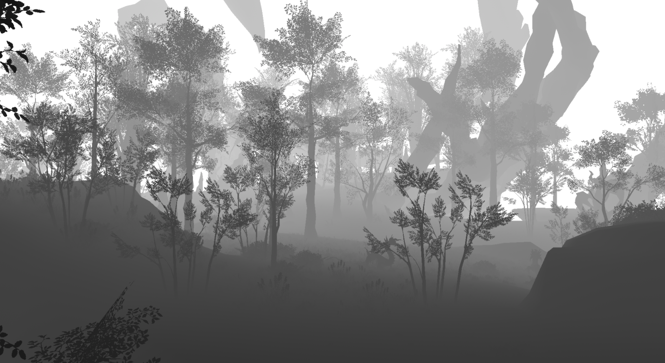
RASTER OPERATIONS
Selina Feitl
Medieninformatik
2998090

Slide 2
TABLE OF CONTENTS
01
02
03
THEMATIC CLASSIFICATION
STENCIL TEST
DEPTH TEST
04
05
BLENDING
Early Z
ANTI-ALIASING
Order Independent Transparency
Nvidia Deep Learning Super Sampling
1

Slide 3
OPENGL GRAPHICS PIPELINE
Vertices
Vertex Processing
Vertices positioned in normalized coordinate space
Primitive Processing
Triangle positioned on screen
Scissor Test
Rasterization
Stencil Test
Fragments
Depth Test
Fragment Processing
Shaded Fragments
Blending
Pixel Operations
Dithering
Framebuffer
2
Notes:
Depth write, stencil write können auch ausgeschalten werden

Slide 4

01
SCISSOR TEST

Slide 5
SCISSOR TEST
= Operation that discards fragments that fall outside of defined rectangular portion of screen
OPENGL
EXAMPLE
glViewport(200,200,100,100);
glScissor(200,200,100,100);
glEnable(GL_SCISSOR_TEST);
glClear(GL_COLOR_BUFFER_BIT);

Slide 6
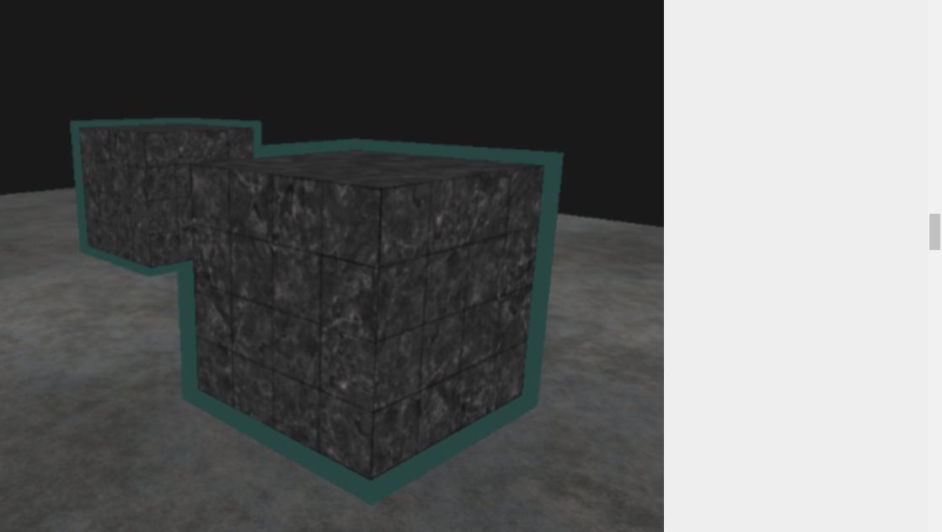
02
STENCIL TEST

Slide 7
STENCIL TEST
OPENGL
Framebuffer
glEnable(GL_STENCIL_TEST);
glStencilOp(GL_KEEP, GL_KEEP, GL_REPLACE);
// Test (discard except for 1)
glStencilFunc(GL_EQUAL, 1, 0xFF)
Depth Buffer/Z-Buffer
APPLICATIONS
Color Buffer
Stores color of fragment that has passed stencil test
Object outlining
Real-time shadow rendering (shadow volumes)
Drawing textures into shapes
Stencil Buffer
Stores 8-bit stencil value per pixel (256 possible values)
→discard fragments for certain values
4

Slide 8
EXAMPLE
Color Buffer
Stencil Buffer
glStencilFunc(GL_EQUAL, 1, 0xFF)
5

Slide 9
EXAMPLE
Color Buffer
Stencil Buffer
1
1
1
1
1
1
1
1
1
1
1
1
1
1
1
1
1
1
1
1
1
1
glStencilFunc(GL_EQUAL, 1, 0xFF)
6

Slide 10
EXAMPLE
Color Buffer
Stencil Buffer
1
1
1
1
1
1
1
1
1
1
1
7

Slide 11
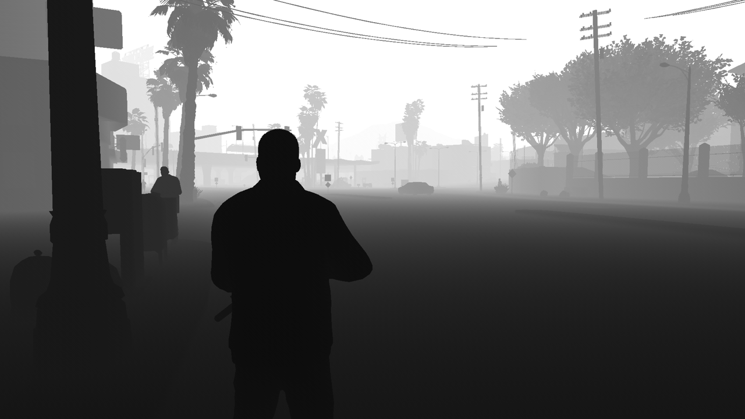
03
DEPTH TEST

Slide 12
DEPTH TEST ALGORITHM
PSEUDOCODE
Framebuffer
bool pass_depth_test (z_new, z_cur){
return z_new < z_cur
}
depth_test (color, x, y, z) {
if (pass_depth_test(z, zbuffer[x][y]) {
zbuffer[x][y] = z;
colorbuffer[x][y] = color;
}
}
Stores depth of closest fragment that has been processed so far
Depth Buffer/Z-Buffer
Color Buffer
Stores color of closest fragment that has been processed so far
Stencil Buffer
9

Slide 13
DEPTH TEST EXAMPLE
Yellow (z = 2)
Red (z = 3)
Green (z = 1)
10

Slide 14
DEPTH TEST EXAMPLE
Depth Buffer
Color Buffer
White: Large Distance
Black: Small Distance
Red: Depth test passed
Yellow (z = 2)
Red (z = 3)
Green (z = 1)
11

Slide 15
DEPTH TEST EXAMPLE
Depth Buffer
Color Buffer
White: Large Distance
Black: Small Distance
Red: Depth test passed
Yellow (z = 2)
Red (z = 3)
Green (z = 1)
12

Slide 16
DEPTH TEST EXAMPLE
Depth Buffer
Color Buffer
White: Large Distance
Black: Small Distance
Red: Depth test passed
Yellow (z = 2)
Red (z = 3)
Green (z = 1)
13

Slide 17
DEPTH TEST EXAMPLE
Depth Buffer
Color Buffer
White: Large Distance
Black: Small Distance
Red: Depth test passed
Yellow (z = 2)
Red (z = 3)
Green (z = 1)
14

Slide 18
DEPTH TEST EXAMPLE
Depth Buffer
Color Buffer
White: Large Distance
Black: Small Distance
Red: Depth test passed
Yellow (z = 2)
Red (z = 3)
Green (z = 1)
15

Slide 19
DEPTH TEST EXAMPLE
Depth Buffer
Color Buffer
White: Large Distance
Black: Small Distance
Red: Depth test passed
Yellow (z = 2)
Red (z = 3)
Green (z = 1)
16

Slide 20
DEPTH TEST EXAMPLE
Depth Buffer
Color Buffer
White: Large Distance
Black: Small Distance
Red: Depth test passed
Yellow (z = 2)
Red (z = 3)
Green (z = 1)
17

Slide 21
DEPTH TEST EXAMPLE
Depth Buffer
Color Buffer
White: Large Distance
Black: Small Distance
Red: Depth test passed
Yellow (z = 2)
Red (z = 3)
Green (z = 1)
18

Slide 22
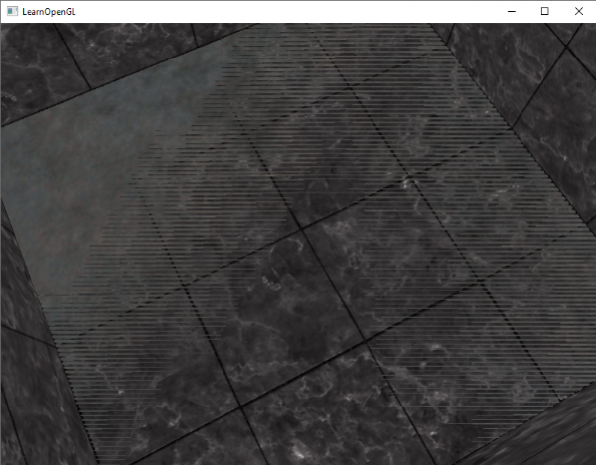
Z-FIGHTING
PROBLEM
depth buffer does not have enough precision to figure out which one of the two shapes is in front of the other
→shapes seem to switch order
SOLUTION
Do not place objects too close to each other
Set near plane further away
Higher precision depth buffer
Source: https://learnopengl.com/Advanced-OpenGL/Depth-testing

Slide 23
EARLY Z
Vertices
Vertex Processing
Primitive Processing
Rasterization
Early Z
If object is not visible at all it can be discarded prematurely
Fragment Shader can not write on depth values
Fragment Processing
Pixel Operations
Framebuffer
19

Slide 24
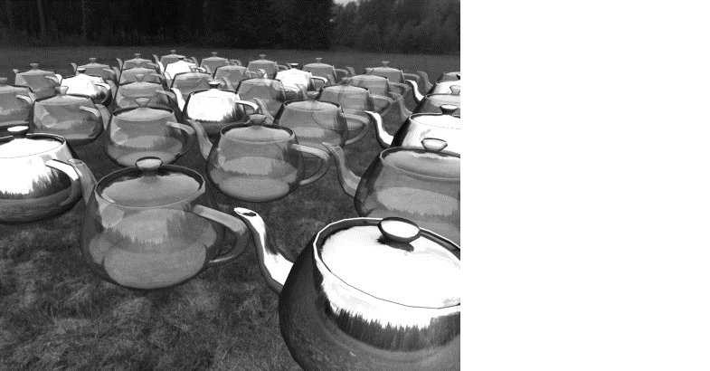
04
BLENDING

Slide 25
BLENDING
= Operation that creates impression of transparency by combining colors
TRANSPARENCY
Alpha value defines level of transparency
→1: object is opaque
→0: object is transparent
Alpha test: Discarding fragments with specific transparency
(1, 0.3, 0.3, 1)
BLENDING
Variables:
C(source): Output color of fragment shader
C(destination): Current color in color buffer
F(source): Source color factor
F(destination): Destination color factor
→Blending Equation:
C(result) = F(source )*C(source)+F(destination)*C(destination)
→Different factors possible
(0, 0.6, 0.6, 0.6)
C(result) = 0.6 * (0, 0.6, 0.6) + (1 – 0.6) * (1, 0.3, 0.3)
21

Slide 26
BLENDING
= Operation that creates impression of transparency by combining colors
TRANSPARENCY
What about this?
Alpha value defines level of transparency
→1: object is opaque
→0: object is transparent
Alpha test: Discarding fragments with specific transparency
(1, 0.3, 0.3, 0.5)
BLENDING
Variables:
C(source): Output color of fragment shader
C(destination): Current color in color buffer
F(source): Source color factor
F(destination): Destination color factor
→Blending Equation:
C(result) = F(source )*C(source)+F(destination)*C(destination)
→Different Factors possible
(0, 0.6, 0.6, 0.5)
C(result) = 0.5 * (0, 0.6, 0.6) + (1 – 0.5) * (0.5, 0.15, 0.15)
22

Slide 27
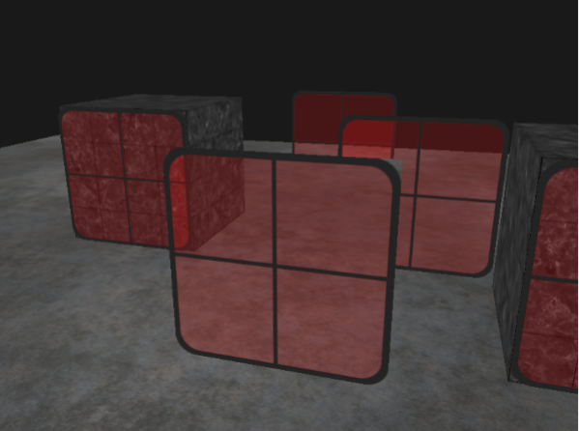
TRANSPARENCY AND DEPTH TEST
PROBLEM
depth test writes “winning” value to depth buffer regardless the transparency
→test discards values that should be visible
SOLUTION
Two rendering loops:
draw opaque elements
Sort transparent elements
draw transparent elements
→takes high processing power
→order-independent transparency
Per pixel linked lists
(dual) depth peeling
Atomic Loop
Source: https://learnopengl.com/Advanced-OpenGL/Blending
23

Slide 28
ORDER INDEPENDENT TRANSPARENCY
GENERAL IDEA
Store fragments per pixel in linked list
Sort values by depth and mix
REQUIRED MEMORY OBJECTS
- | - | - | -
- | - | - | -
- | - | - | -
- | - | - | -
Node
Color
Depth
Next
With per pixel linked lists
0
Atomic counter:
Tracks size of linked list buffer
Indicates next free slot in buffer
Head-pointer texture:
Corresponds to screen size
Stores head pointers for linked list
Linked list buffer:
Stores linked fragments
24

Slide 29
ORDER INDEPENDENT TRANSPARENCY
With per pixel linked lists
1ST PASS:
Fill linked list buffer
Head pointer texture
- | - | - | -
- | - | - | -
- | - | - | -
- | - | - | -
Node1
C: …
D: 0.7f
Next: ?
New fragment
( 0 , 1 )
Atomic counter
0
Linked list buffer
25

Slide 30
ORDER INDEPENDENT TRANSPARENCY
With per pixel linked lists
1ST PASS:
Fill linked list buffer
Head pointer texture
- | - | - | -
0 | - | - | -
- | - | - | -
- | - | - | -
Node1
C: …
D: 0.7f
Next: ?
New fragment
( 0 , 1 )
Atomic counter
1
Linked list buffer
26

Slide 31
ORDER INDEPENDENT TRANSPARENCY
With per pixel linked lists
1ST PASS:
Fill linked list buffer
Head pointer texture
- | - | - | -
0 | - | - | -
- | - | - | -
- | - | - | -
Node1
C: …
D: 0.7f
Next: ?
New fragment
( 0 , 1 )
Atomic counter
1
Linked list buffer
0
C: … D: 0.7f Next: -
27

Slide 32
ORDER INDEPENDENT TRANSPARENCY
With per pixel linked lists
1ST PASS:
Fill linked list buffer
Head pointer texture
- | - | - | -
0 | - | - | -
- | - | - | -
- | - | - | -
Node2
C: …
D: 0.3f
Next: ?
New fragment
( 2 , 2 )
Atomic counter
1
Linked list buffer
0
C: … D: 0.7f Next: -
28

Slide 33
ORDER INDEPENDENT TRANSPARENCY
With per pixel linked lists
1ST PASS:
Fill linked list buffer
Head pointer texture
- | - | - | -
0 | - | - | -
- | - | 1 | -
- | - | - | -
Node2
C: …
D: 0.3f
Next: ?
New fragment
( 2 , 2 )
Atomic counter
2
Linked list buffer
0
C: … D: 0.7f Next: -
29

Slide 34
ORDER INDEPENDENT TRANSPARENCY
With per pixel linked lists
1ST PASS:
Fill linked list buffer
Head pointer texture
- | - | - | -
0 | - | - | -
- | - | 1 | -
- | - | - | -
Node2
C: …
D: 0.3f
Next: ?
New fragment
( 2 , 2 )
Atomic counter
2
Linked list buffer
0 | 1
C: … D: 0.7f Next: - | C: … D: 0.3f Next: -
30

Slide 35
ORDER INDEPENDENT TRANSPARENCY
With per pixel linked lists
1ST PASS:
Fill linked list buffer
Head pointer texture
- | - | - | -
0 | - | - | -
- | - | 1 | -
- | - | - | -
Node3
C: …
D: 0.5f
Next: ?
New fragment
( 0 , 1 )
Atomic counter
2
Linked list buffer
0 | 1
C: … D: 0.7f Next: - | C: … D: 0.3f Next: -
31

Slide 36
ORDER INDEPENDENT TRANSPARENCY
With per pixel linked lists
1ST PASS:
Fill linked list buffer
Head pointer texture
- | - | - | -
2 | - | - | -
- | - | 1 | -
- | - | - | -
Node3
C: …
D: 0.5f
Next: ?
New fragment
( 0 , 1 )
Atomic counter
3
Linked list buffer
0 | 1
C: … D: 0.7f Next: - | C: … D: 0.3f Next: -
32

Slide 37
ORDER INDEPENDENT TRANSPARENCY
With per pixel linked lists
1ST PASS:
Fill linked list buffer
Head pointer texture
- | - | - | -
2 | - | - | -
- | - | 1 | -
- | - | - | -
Node3
C: …
D: 0.5f
Next: ?
New fragment
( 0 , 1 )
Atomic counter
3
Linked list buffer
0 | 1 | 2
C: … D: 0.7f Next: - | C: … D: 0.3f Next: - | C: … D: 0.5 Next: 0 | …
33

Slide 38
ORDER INDEPENDENT TRANSPARENCY
With per pixel linked lists
1ST PASS:
Fill linked list buffer
2ND PASS:
Draw fragments per pixel
Head pointer texture
- | - | - | -
3 | - | - | -
- | - | 4 | -
- | - | - | -
0 | 1 | 2 | 3 | 4
C: … D: 0.7f Next: - | C: … D: 0.3f Next: - | C: … D: 0.5f Next: 0 | C: … D: -2.0f Next: 2 | C: … D: 1.5f Next: 1
- | - | - | -
3 | - | - | -
- | - | 4 | -
- | - | - | -
load
Atomic counter
Linked list buffer
5
0 | 1 | 2 | 3 | 4
C: … D: 0.7f Next: - | C: … D: 0.3f Next: - | C: … D: 0.5f Next: 0 | C: … D: -2.0f Next: 2 | C: … D: 1.5f Next: 1
34

Slide 39
ORDER INDEPENDENT TRANSPARENCY
With per pixel linked lists
1ST PASS:
Fill linked list buffer
2ND PASS:
Draw fragments per pixel
Head pointer texture
- | - | - | -
3 | - | - | -
- | - | 4 | -
- | - | - | -
0 | 1 | 2 | 3 | 4
C: … D: 0.7f Next: - | C: … D: 0.3f Next: - | C: … D: 0.5f Next: 0 | C: … D: -2.0f Next: 2 | C: … D: 1.5f Next: 1
- | - | - | -
3 | - | - | -
- | - | 4 | -
- | - | - | -
load
Atomic counter
Linked list buffer
5
fragmentArray [[
],[
],[
]]
C: …
D: -2.0f
Next: 2
C: …
D: 0.5f
Next: 0
C: …
D: 0.7f
Next: -
0 | 1 | 2 | 3 | 4
C: … D: 0.7f Next: - | C: … D: 0.3f Next: - | C: … D: 0.5f Next: 0 | C: … D: -2.0f Next: 2 | C: … D: 1.5f Next: 1
Sort (largest to smallest)
fragmentArray [[
],[
],[
]]
C: …
D: 0.7f
Next: -
C: …
D: 0.5f
Next: 0
C: …
D: -2.0f
Next: 2
Mix-function to blend in order
35

Slide 40
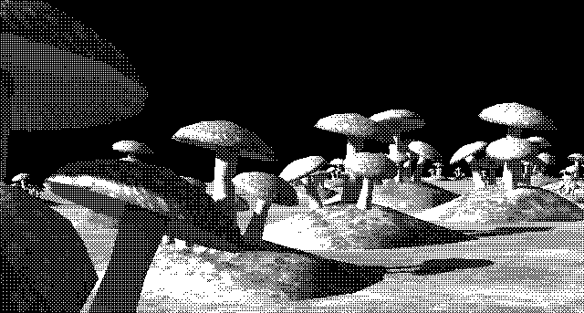
05
DITHERING

Slide 41
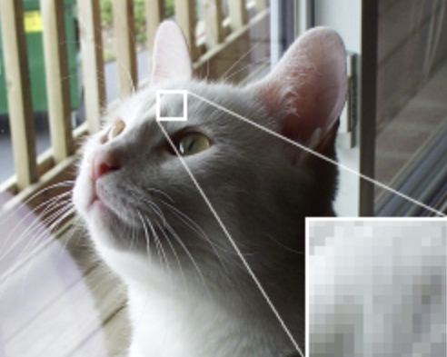
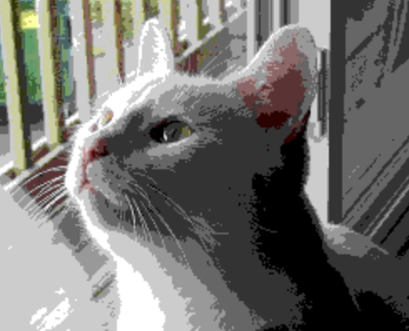

DITHERING
IDEA
Original image
Some devices have restricted color palette (8 Bit per Pixel)
Mixing of colors to simulate missing colors
CATEGORIES
Image with 8 bit color palette
Treshold dithering
→if (p<t) then p=a else p=b;
Error diffusion dithering (rounding error compensated by neighboring pixels)
Image with dithering
Source: http://alex-charlton.com/posts/Dithering_on_the_GPU/

Slide 42
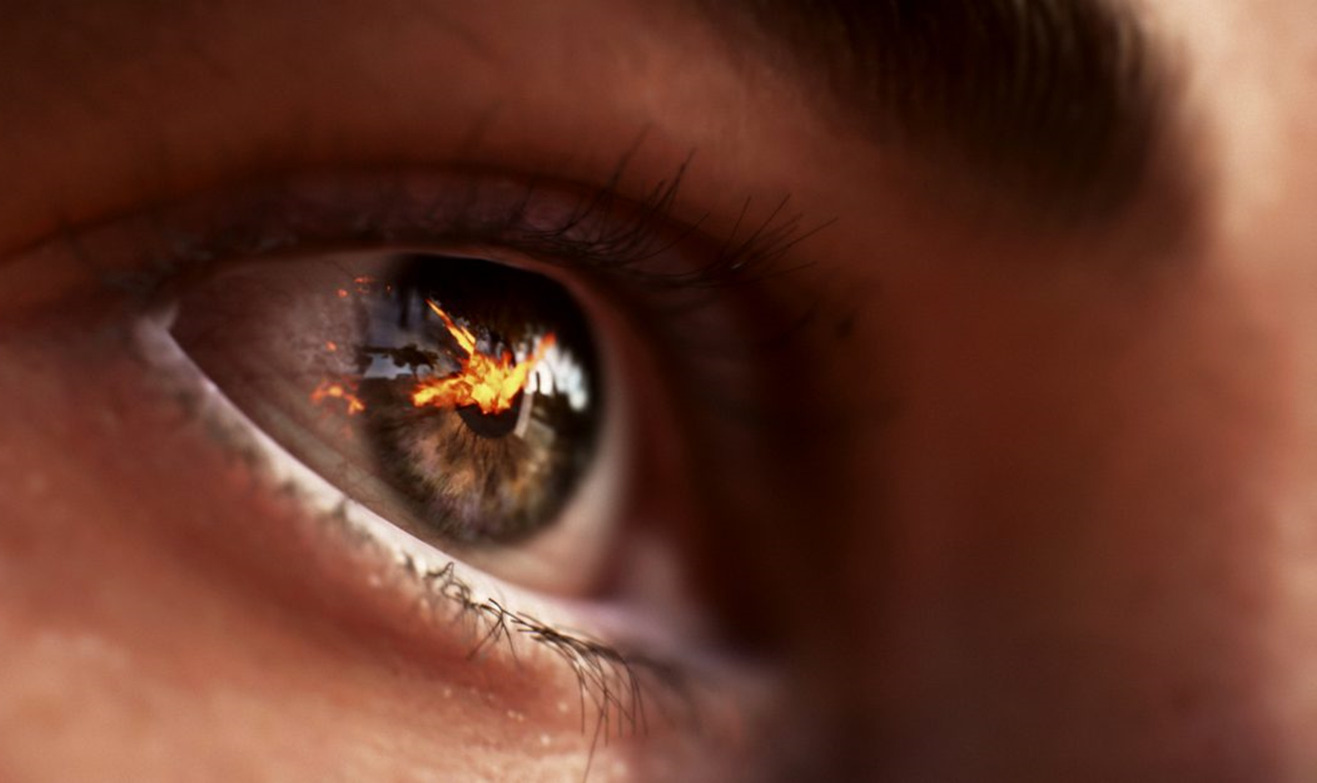
05
ANTI ALIASING

Slide 43
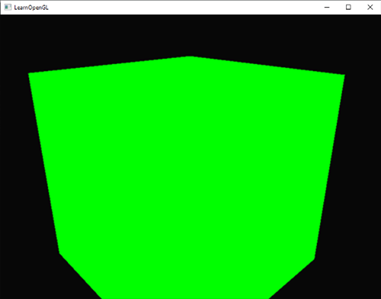
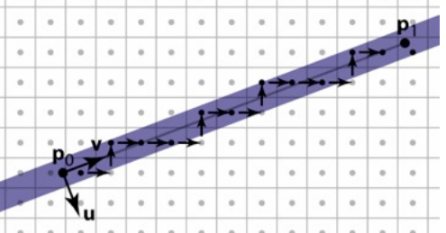

ANTI ALIASING
= technique to produce smoother edges
ALIASING
Rasterizer transforms vertices into fragments
Fragments can not have any coordinate (bound to screen resolution)
Determination of pixel colering by coverage of pixel center
Limited amount of pixels produces jagged edges
Source: https://learnopengl.com/Advanced-OpenGL/Anti-Aliasing
Source: http://www.cs.cornell.edu/courses/cs4620/2013fa/lectures/09rasterization.pdf
37

Slide 44
MULTISAMPLE ANTI ALIASING
= technique to produce smoother edges
ALIASING
Rasterizer transforms vertices into fragments
Fragments can not have any coordinate (bound to screen resolution)
Determination of pixel colering by coverage of pixel center
Limited amount of pixels produces jagged edges
Source: https://learnopengl.com/Advanced-OpenGL/Anti-Aliasing
Source: http://www.cs.cornell.edu/courses/cs4620/2013fa/lectures/09rasterization.pdf
Idea: Determination of pixel coverage by more subsamples
→color pixel proportionally
38

Slide 45
MULTISAMPLE ANTI ALIASING
= technique to produce smoother edges
ALIASING
Rasterizer transforms vertices into fragments
Fragments can not have any coordinate (bound to screen resolution)
Determination of pixel colering by coverage of pixel center
Limited amount of pixels produces jagged edges
Source: https://learnopengl.com/Advanced-OpenGL/Anti-Aliasing
Source: http://www.cs.cornell.edu/courses/cs4620/2013fa/lectures/09rasterization.pdf
SOLUTION
Idea: Determination of pixel coverage by more subsamples
→color pixel proportionally
39

Slide 46

MULTISAMPLE ANTI ALIASING
= technique to produce smoother edges
ALIASING
Rasterizer transforms vertices into fragments
Fragments can not have any coordinate (bound to screen resolution)
Determination of pixel colering by coverage of pixel center
Limited amount of pixels produces jagged edges
Source: https://learnopengl.com/Advanced-OpenGL/Anti-Aliasing
Source: http://www.cs.cornell.edu/courses/cs4620/2013fa/lectures/09rasterization.pdf
SOLUTION
Idea: Determination of pixel coverage by more subsamples
→color pixel proportionally
40

Slide 47
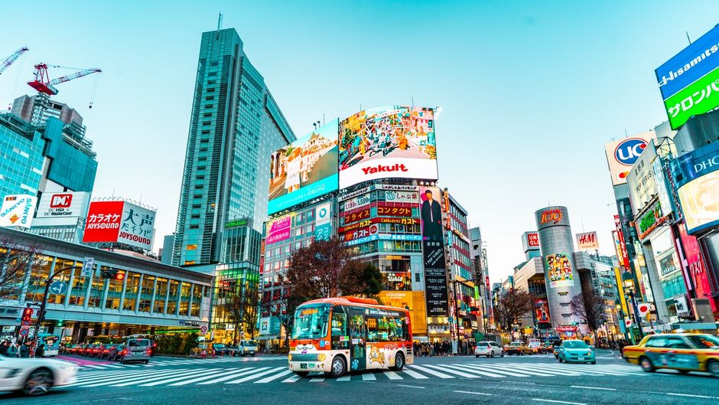
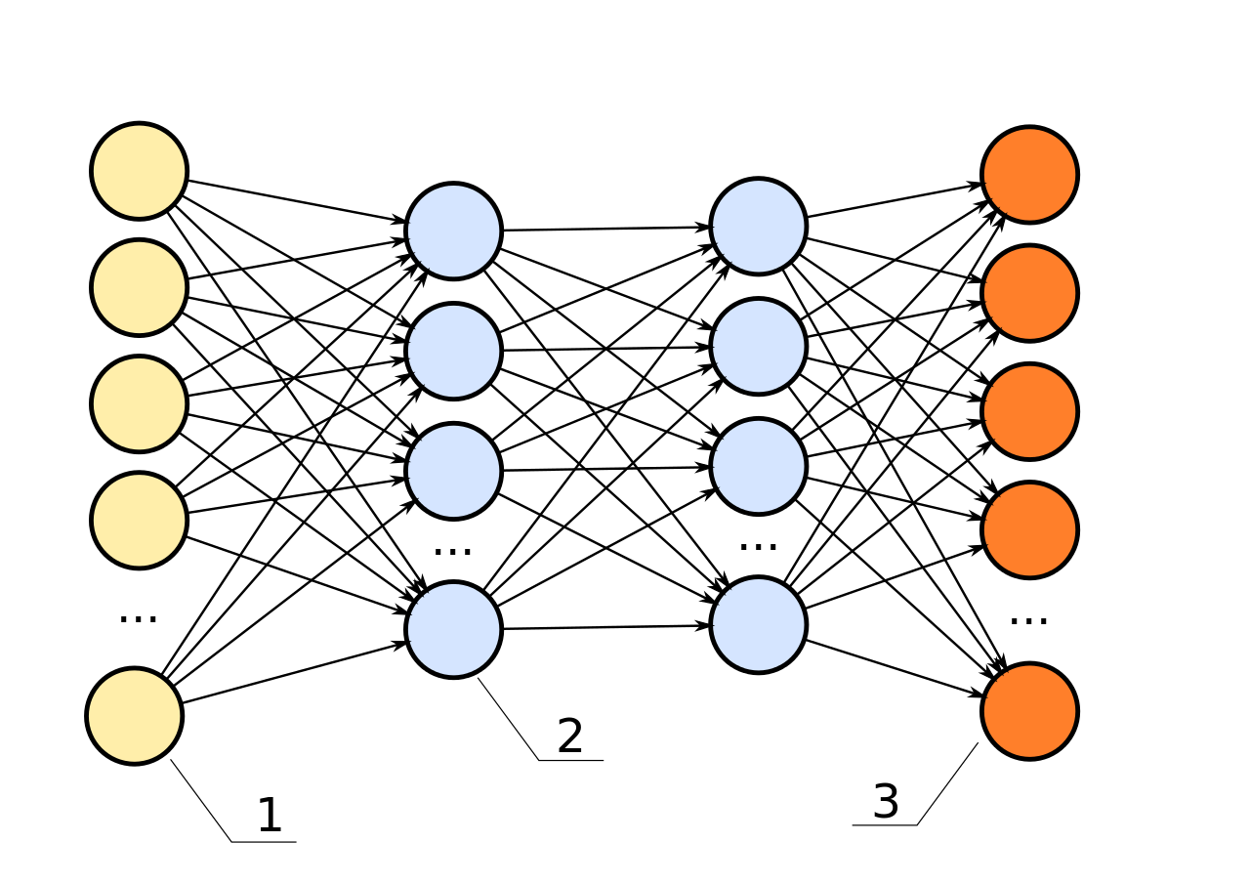
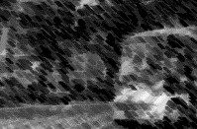
NVIDIA DEEP LEARNING SUPER SAMPLING
IDEA
1. Estimate next frame with motion vector and previous output
2. Compare input to output to improve network
3. Compare output to ultra-high quality output to further improve network
1080p aliased, jittered pixels
Convolutional Autoencoder
4k Anti-Aliased Output
16k Anti-Aliased Output
Rendering fewer pixels and then using deep learning neural network to construct higher resolution images
→high frame rate and high image resolution
Temporal Feedback
1080p motion vectors
41

Slide 48
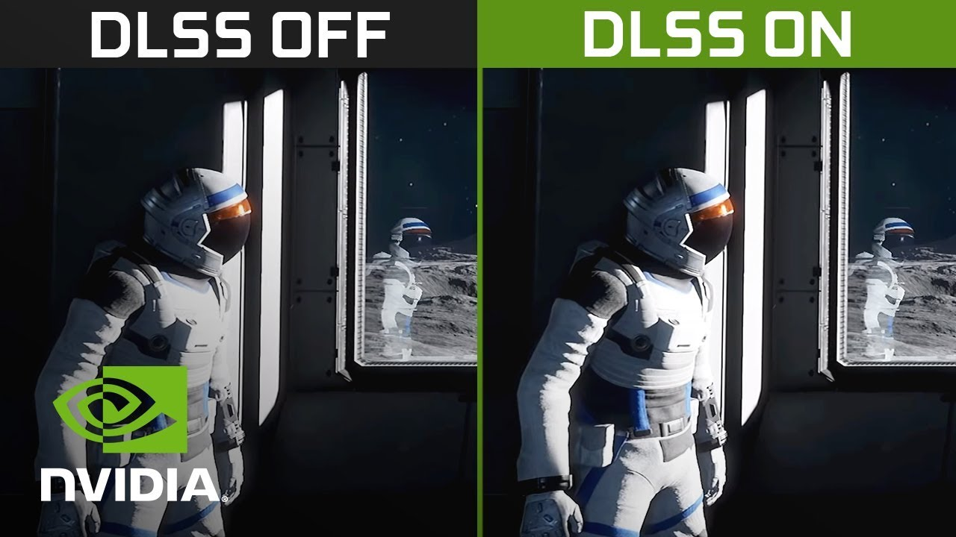
NVIDIA DEEP LEARNING SUPER SAMPLING
IDEA
Rendering fewer pixels and then using deep learning neural network to contruct higher resolution images
→high frame rate and high image resolution
42

Slide 49
RESOURCES
Khronos. “Main Page.” OpenGL Wiki, 26 Sept. 2018, www.khronos.org/opengl/wiki., accessed 10.11.2020
“DLSS-Technologie Für Unglaubliche Leistung.” NVIDIA, 2020, www.nvidia.com/de-de/geforce/technologies/dlss/. , accessed 12.11.20
de Vries, Joey. “Depth Testing.” LearnOpenGL, 2020, learnopengl.com/Advanced-OpenGL/Depth-testing. , accessed 10.11.2020
de Vries, Joey. “Stencil Testing.” LearnOpenGL, 2020, learnopengl.com/Advanced-OpenGL/Stencil-testing. , accessed 10.11.2020
de Vries, Joey. “Anti Aliasing.” LearnOpenGL, 2020, learnopengl.com/Advanced-OpenGL/Anti-Aliasing. , accessed 10.11.2020
de Vries, Joey. “Blending.” LearnOpenGL, 2020, learnopengl.com/Advanced-OpenGL/Blending. , accessed 10.11.2020
Wolff, David. 2018. “OpenGL 4 Shading Language Cookbook: Build high-quality, real-time 3D graphics with OpenGL 4.6, GLSL 4.6 and C++17”, 3rd Edition. Packt Publishing.
“Fragment Processing.” Fragment Processing - an Overview | ScienceDirect Topics, Elsevier B.V., 2020, www.sciencedirect.com/topics/computer-science/fragment-processing. , accessed 20.11.20
Home, OpenGl Tutorial, 7 June 2017, www.opengl-tutorial.org/. , last accessed 22.11.20

